Slide 2
21st ICL 2024
Organisational & financial report
prof. Katarzyna Dziubalska-Kołaczyk
AMU Poznań
dkasia@amu.edu.pl
Leiden, 23rd April 2025

Slide 3


Organisers
Adam Mickiewicz University, Poznań (AMU)
Permanent International Committee of Linguists (CIPL)
in cooperation with MTP (Poznań International Fair)
AMU as the first University in Poland to organise the ICL
3

Slide 4





Honorary patronage
4

Slide 5
ICL 2024
The leitmotif of ICL 2024 was Languages - Communities - Technologies
We received more than 750 registrations
12 plenary lectures, 17 thematic sessions, 12 focus streams, 17 workshops
The congress themes emphasised the multifaceted and interdisciplinary nature of linguistics as a research area
The thematic sessions of the congress addressed socially current issues, including endangered languages, multilingualism, artificial intelligence, language & technology
There was also a full-day session on sign language, which was simultaneously interpreted by a team of highly specialised interpreters
6

Slide 6

Organising committee
President: Prof. Katarzyna Dziubalska-Kołaczyk (Vice-rector of Adam Mickiewicz University, Faculty of English, Adam Mickiewicz University)
Vice-president: Prof. Joanna Pawelczyk (Dean of the Faculty of English, Adam Mickiewicz University)
Secretaries: Dr Jarosław Weckwerth (Faculty of English, Adam Mickiewicz University ), Dr Dominika Gapska (School of Languages and Literatures, Adam Mickiewicz University)
Treasurer: Ms. Agnieszka Jędraszyk (Deputy Bursar, Adam Mickiewicz University)
Publicity manager: Prof. Paweł Korpal (Faculty of English, Adam Mickiewicz University)
Prof. Camiel Hamans (CIPL; University of Amsterdam & Adam Mickiewicz University)
Prof. Katarzyna Klessa (Adam Mickiewicz University, Faculty of Modern Languages and Literatures)
Prof. Eugeniusz Cyran (Faculty of Humanities, The John Paul II Catholic University of Lublin)
Prof. Tomasz Lisowski (Faculty of Polish and Classical Philology, AMU)
Prof. Małgorzata Fabiszak (Faculty of English, Adam Mickiewicz University)
Prof. Paula Orzechowska (Faculty of English, Adam Mickiewicz University)
Ms. Agnieszka Stefańska (Science Support Office, Adam Mickiewicz University)
Dr Ewelina Wojtkowiak (Faculty of English, Adam Mickiewicz University)
Mgr Zuzanna Cal (Faculty of English, Adam Mickiewicz University)
7

Slide 7
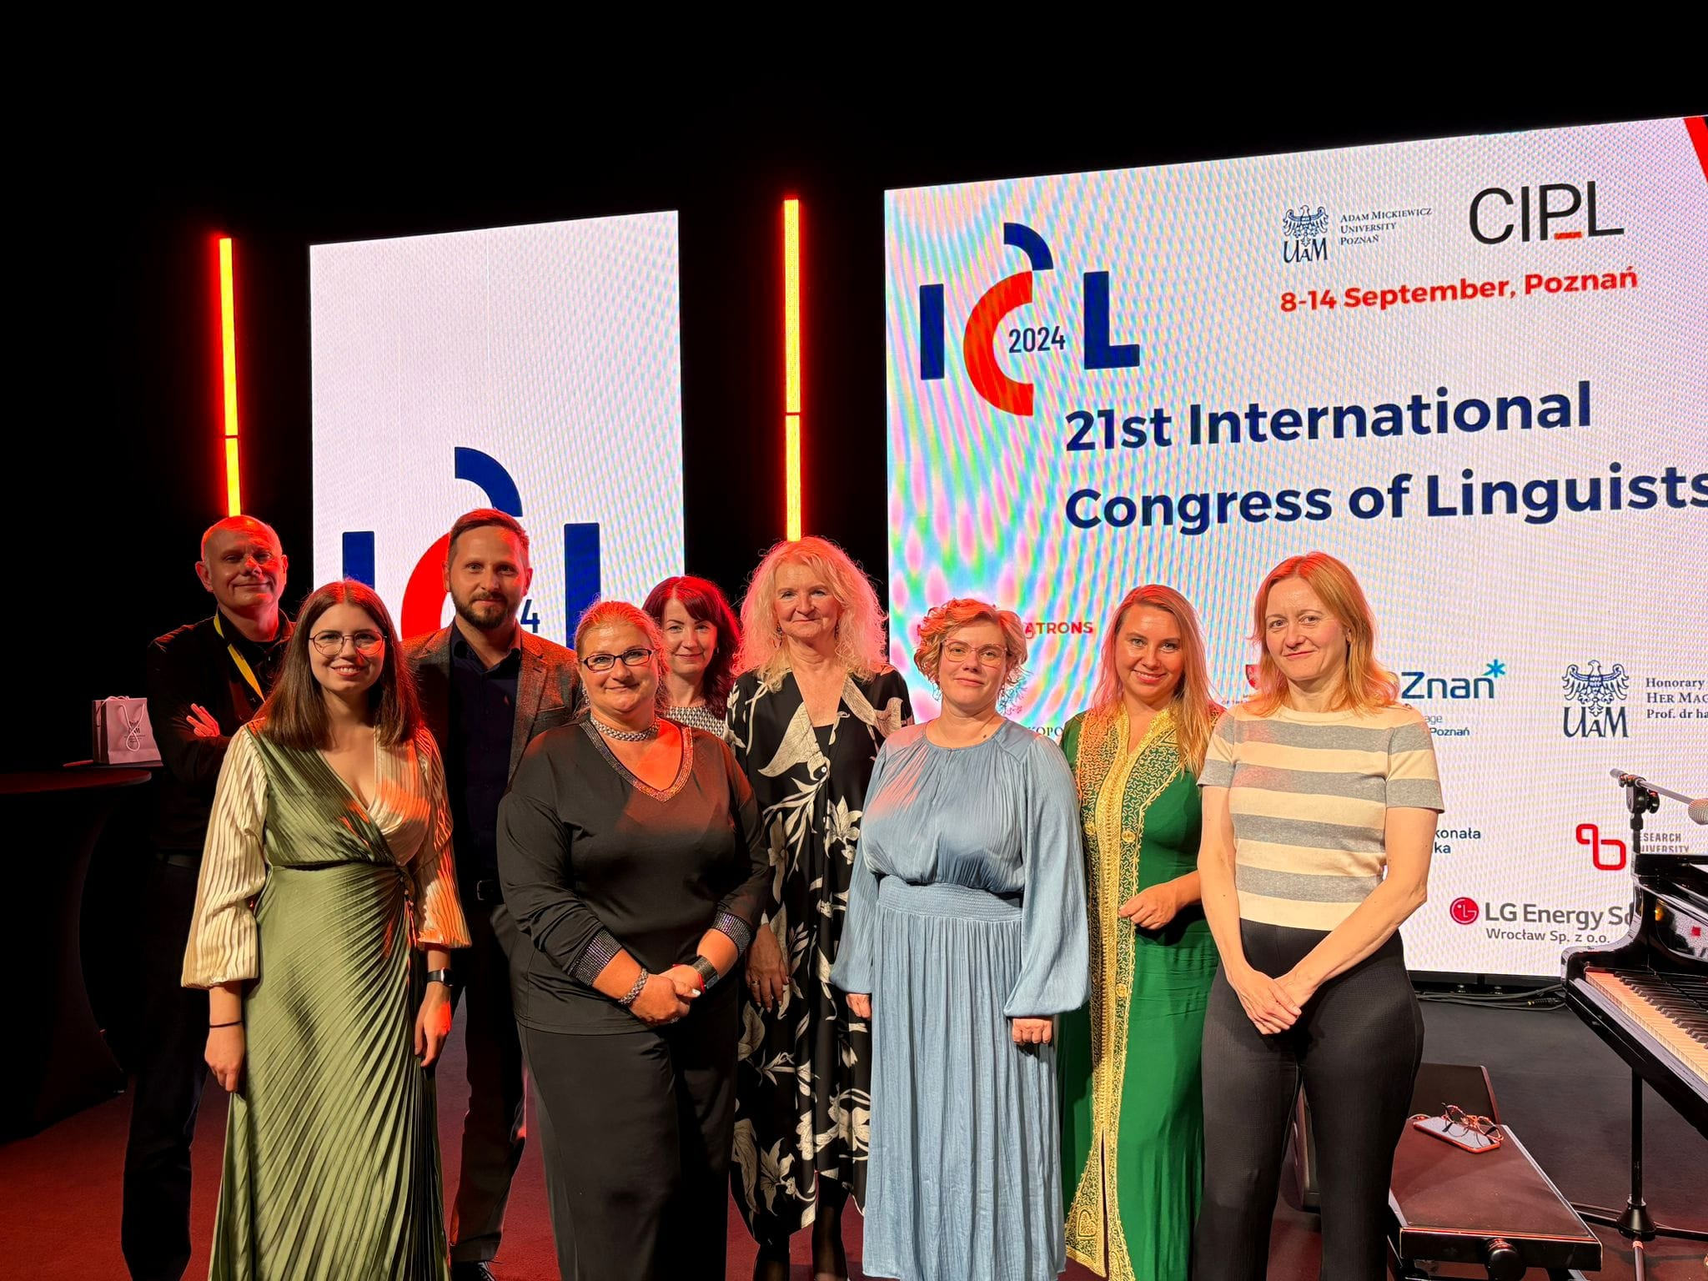
8

Slide 8
Scientific committee
Prof. David Bradley, Chair of the Committee (CIPL)
Prof. Ik-Hwan Lee (Vice-President of CIPL)
Prof. Frieda Steurs, Secretary of the Committee, (KU Leuven, CIPL)
Prof. Eno Abasi-Urua (University of Uyo, Nigeria, CIPL)
Prof. Frederick Newmeyer (CIPL)
Prof. Miguel Oliveira (CIPL)
Prof. Camiel Hamans, Acting Secretary (CIPL)
Prof. Rafał Molencki (University of Silesia, Katowice)
Prof. Marzena Żygis (Leibniz Centre for General Linguistics)
Prof. Justyna Olko (Artes Liberales, University of Warsaw)
Prof. Jacek Witkoś (Adam Mickiewicz University in Poznań)
Prof. Marcin Kilarski (Adam Mickiewicz University in Poznań)
Prof. Agnieszka Kiełkiewicz-Janowiak (Adam Mickiewicz University in Poznań)
Prof. Nikolaus Ritt (University of Vienna)
Prof. Adam Przepiórkowski (University of Warsaw & Polish Academy of Sciences)
Prof. Zofia Wodniecka (Jagiellonian University, Cracow)
9

Slide 9
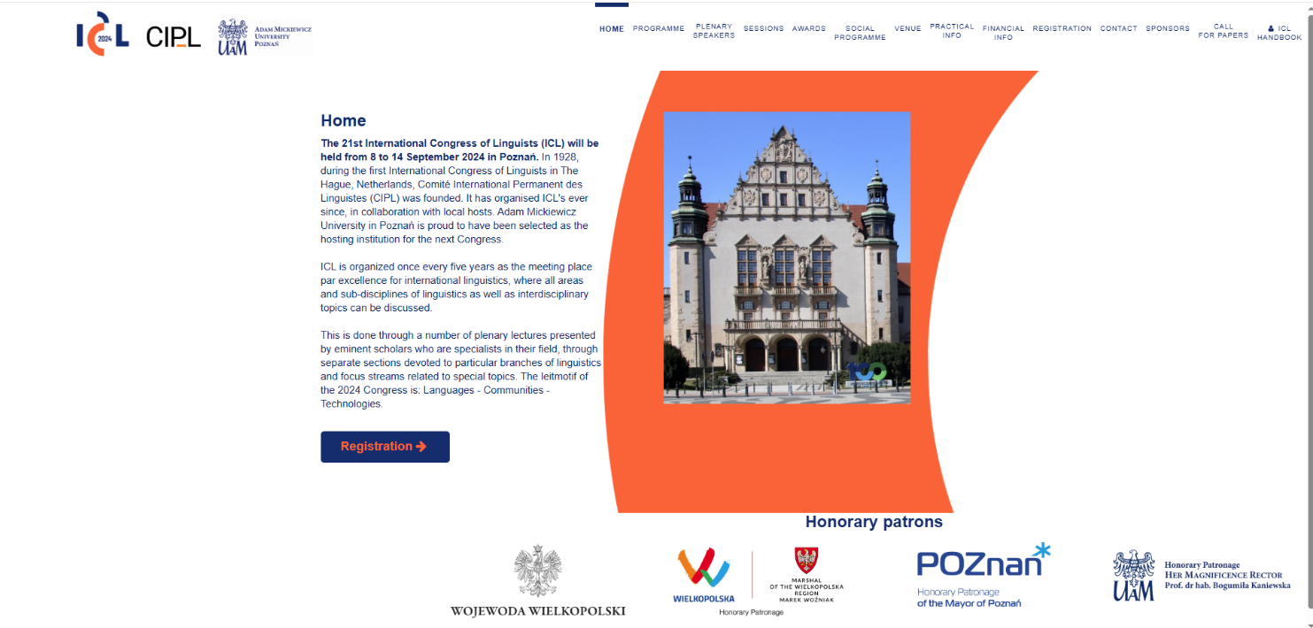
Website
https:\\www.icl2024poznan.pl
10

Slide 10

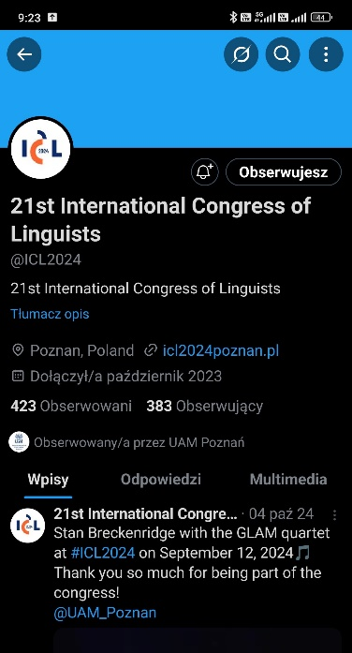
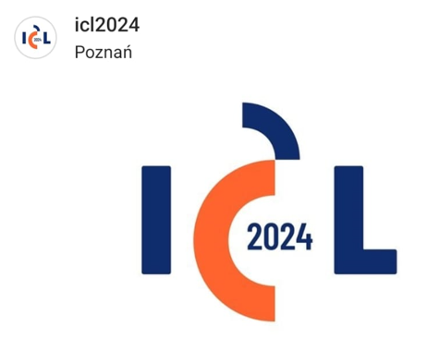
Social media
Facebook
„X”
Instagram
11

Slide 11
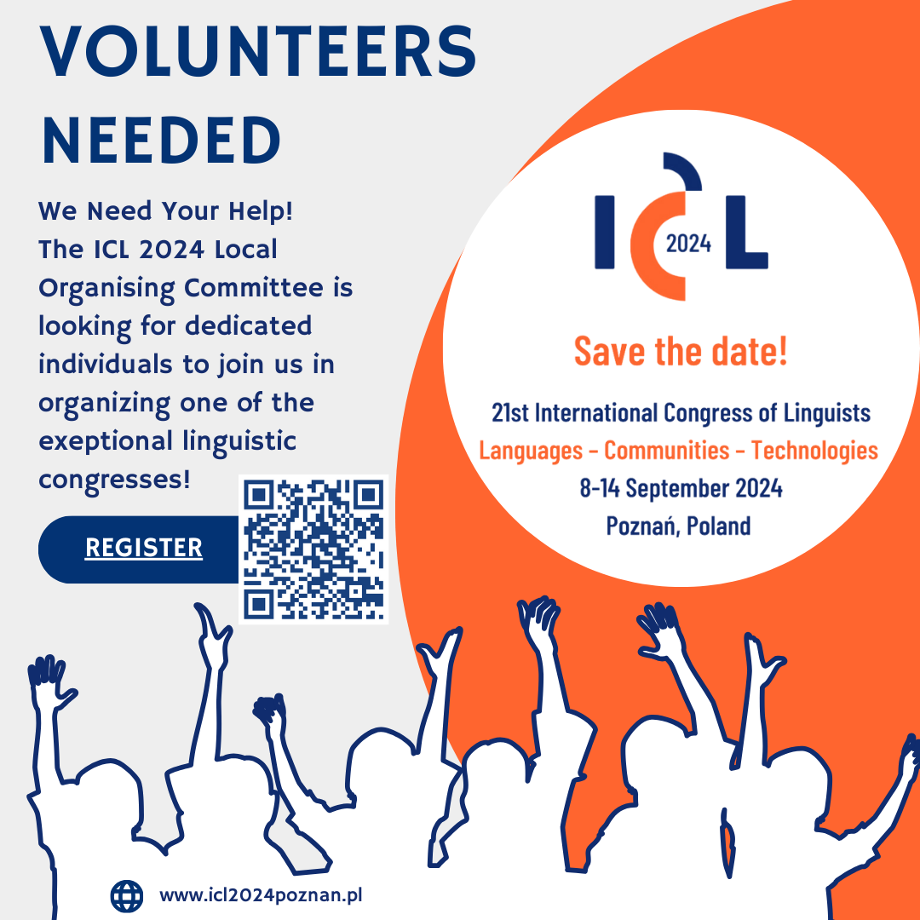
Support
About 40 volunteers, recruited among UAM students, were involved in the organisation of the congress.
Their main tasks were:
taking care of international guests
handling registration for participants
handling discussion panels
supporting the session staff
volunteers were also on duty at Ławica Airport
12

Slide 12
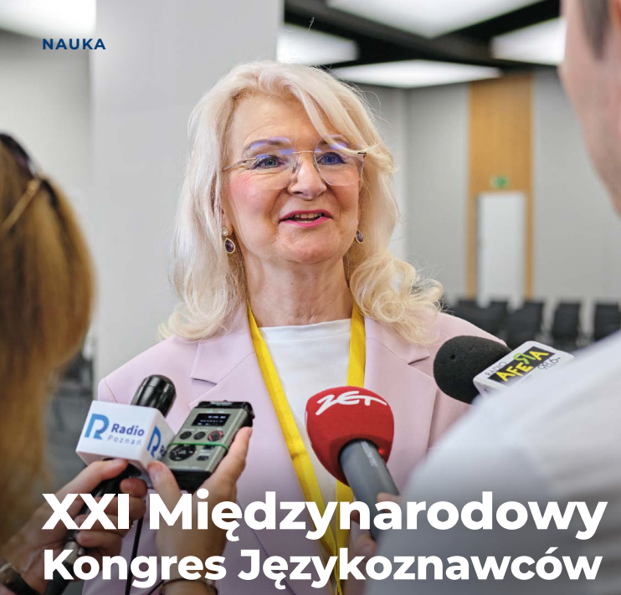
ICL 2024 – media
Links to press releases
Życie Uniwersyteckie
UAM
Głos Wielkopolski
Forum Akademickie
Radio ESKA
Grupa MTP
https://radiopoznan.fm/informacje/pozostale/swiatowe-jezykoznawstwo-w-poznaniu-setki-naukowcow-z-calego-swiata
Życie Uniwersyteckie Nr 10/2024
Fot. Władysław Gardasz
13

Slide 13
Materiał filmowy
https://www.youtube.com/watch?v=tssSVb6hqAM
14

Slide 14
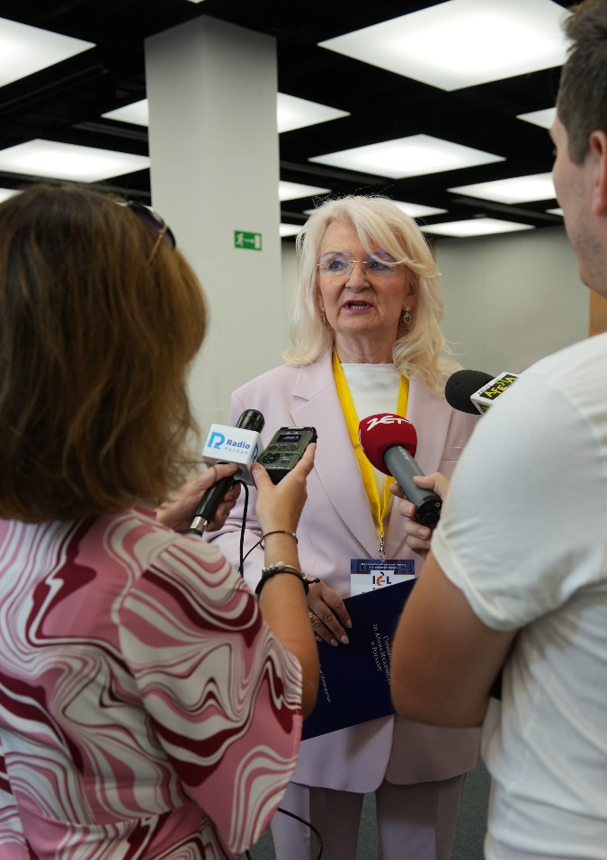
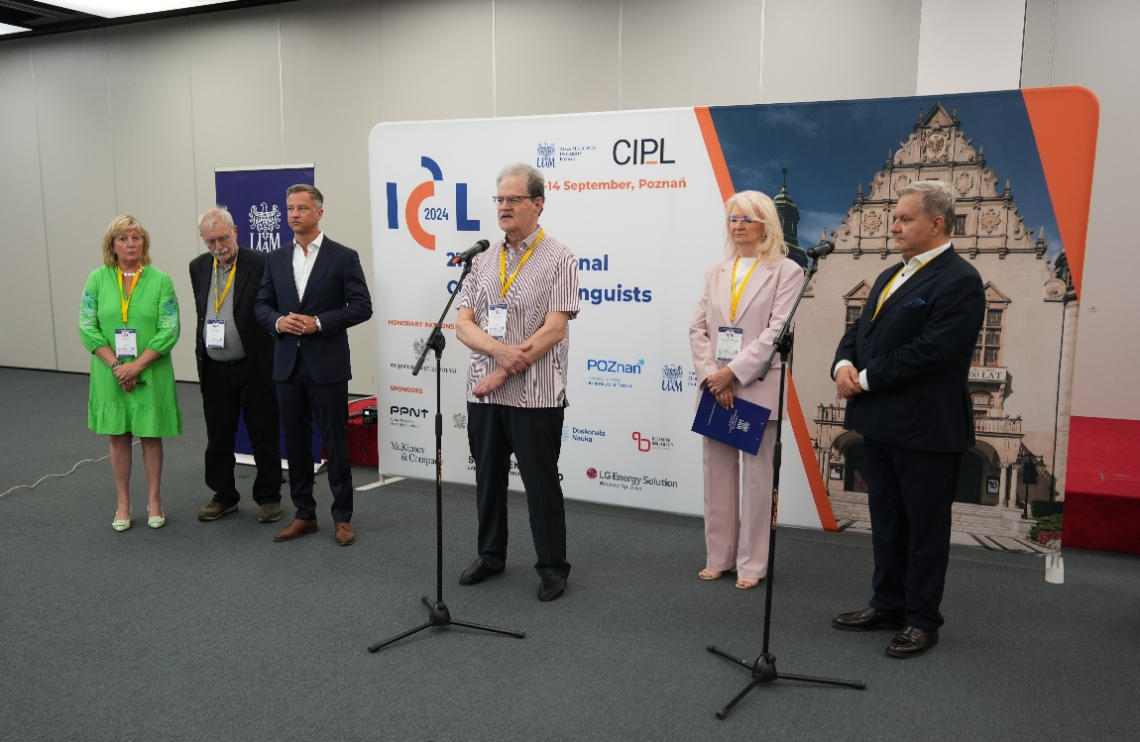
ICL 2024 – press conference
15

Slide 15
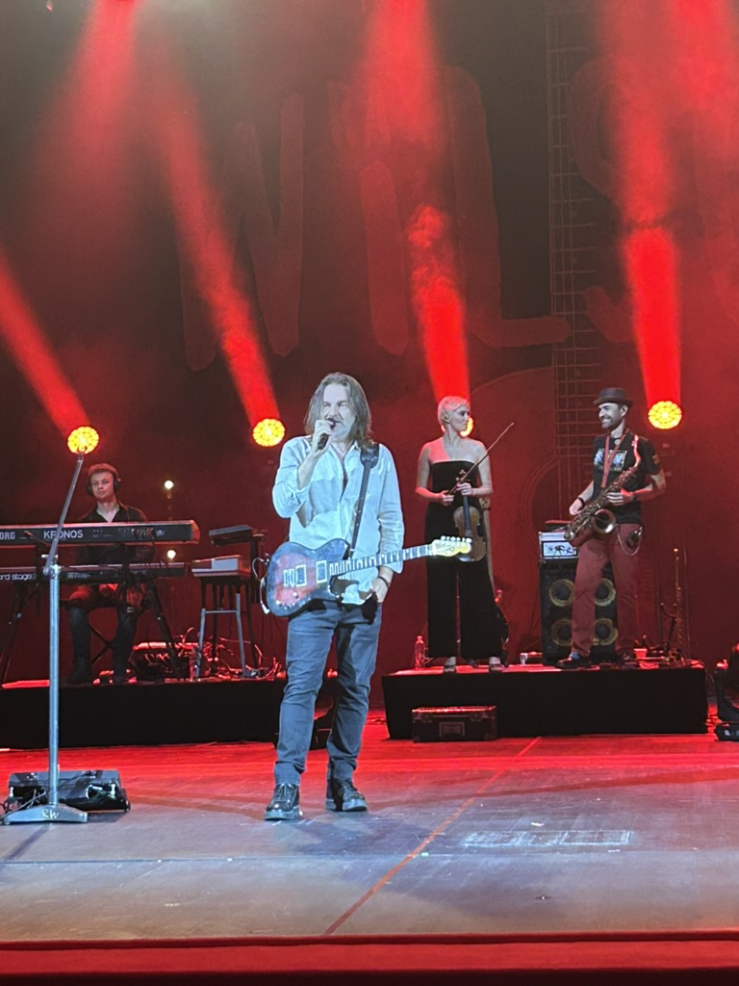

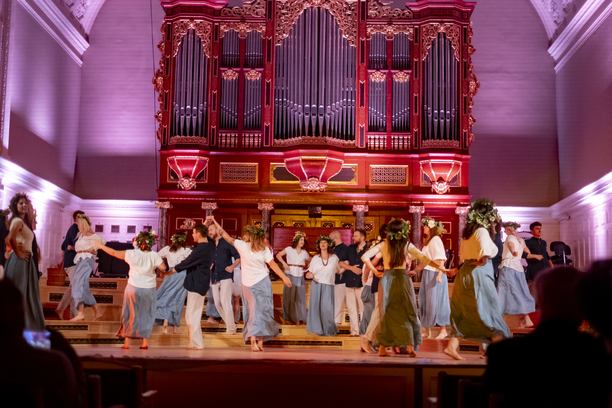
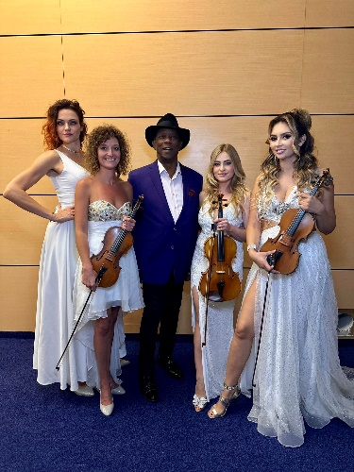

Social programme
Sunday 08 September, 20:30
Welcome reception and glass of wine. Available to all registered participants.
Location: Collegium Maius, Fredry 10, 61-701 Poznań
Monday 09 September, 20:00
Concert by Ray Wilson. Available to all registered participants.
Location: The Grand Theatre (Opera House), Fredry 9, 61-701 Poznań
Tuesday 10 September, 20:00
Concert. Available to all registered participants.
Location: Adam Mickiewicz University Aula (Poznań Philharmonic), Wieniawskiego 1, 60-702 Poznań
Wednesday 11 September, 17:00
City Walk with the Poznań Tourist Organization.
Further details will be given by the Poznań Convention Bureau at the registration desk.
Thursday 12 September, 20:00
Congress Dinner. Available to paying participants.
Location: Earth Hall (Sala Ziemi), Poznań Congress Center.
Saturday 14 September
Excursions:
1. The Rogalin Palace, Rogalin Landscape Park and Kórnik Castle tour (1 day, 65 EUR/person)
https://idealtravel.pl/icl2024/ Registration closes on 6 Sep (23:59 local time).
2. The Sweetest Treasure of Poznan tour (1 hour, 39 PLN/person)
https://rogalowemuzeum.pl/rezerwacje-grupowe/?daid=25192 Registration closes on 11 Sep (23:59 local time).
3. The Poznań Feast tour (3.5 hours, 215 PLN/person)
https://cityevent-poznan.pl/tour/ilc-2024-poznan-feast-tour/ Registration closes on 12 Sep (23:59 local time).
Saturday 7 Sep – Sunday 15 Sep
Malta Festival of performing arts. While we are not affiliated with the festival in any way,
it is a staple annual event on the Poznań cultural scene, highly international,
with some free events in the public spaces of the city, and some ticketed events.
https://malta-festival.pl/
Other events
Other cultural events can be found on the Visit Poznań and Co? Gdzie? Kiedy? websites:
https://visitpoznan.pl/en
https://www.poznan.pl/mim/events/en/
16

Slide 16
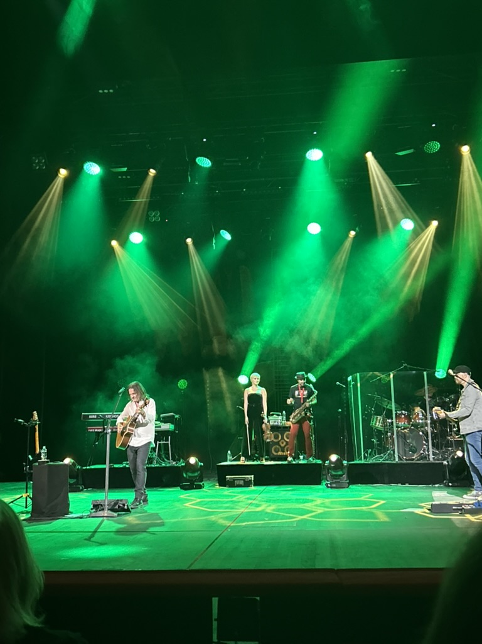
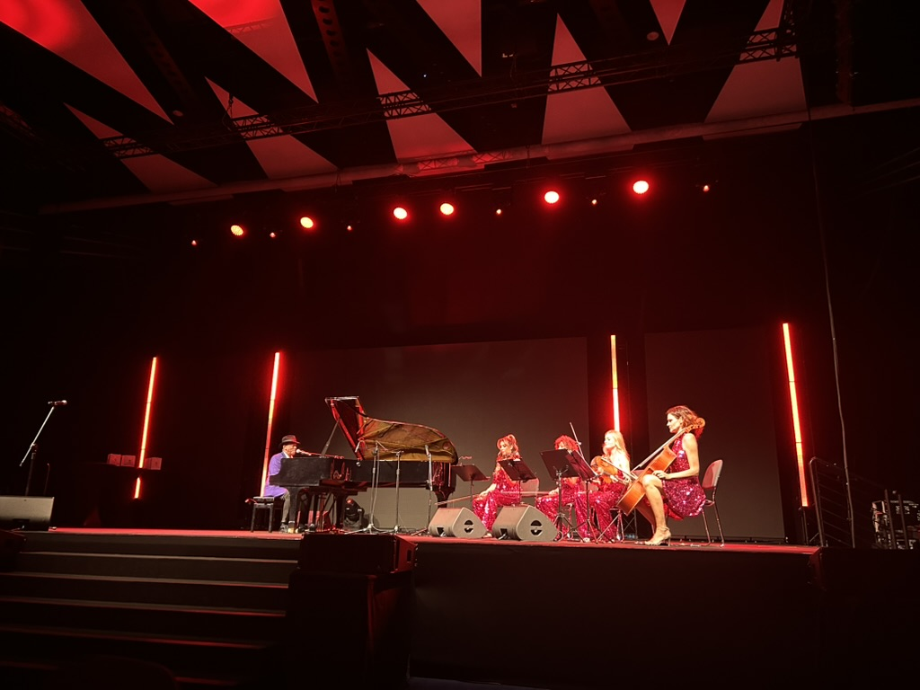
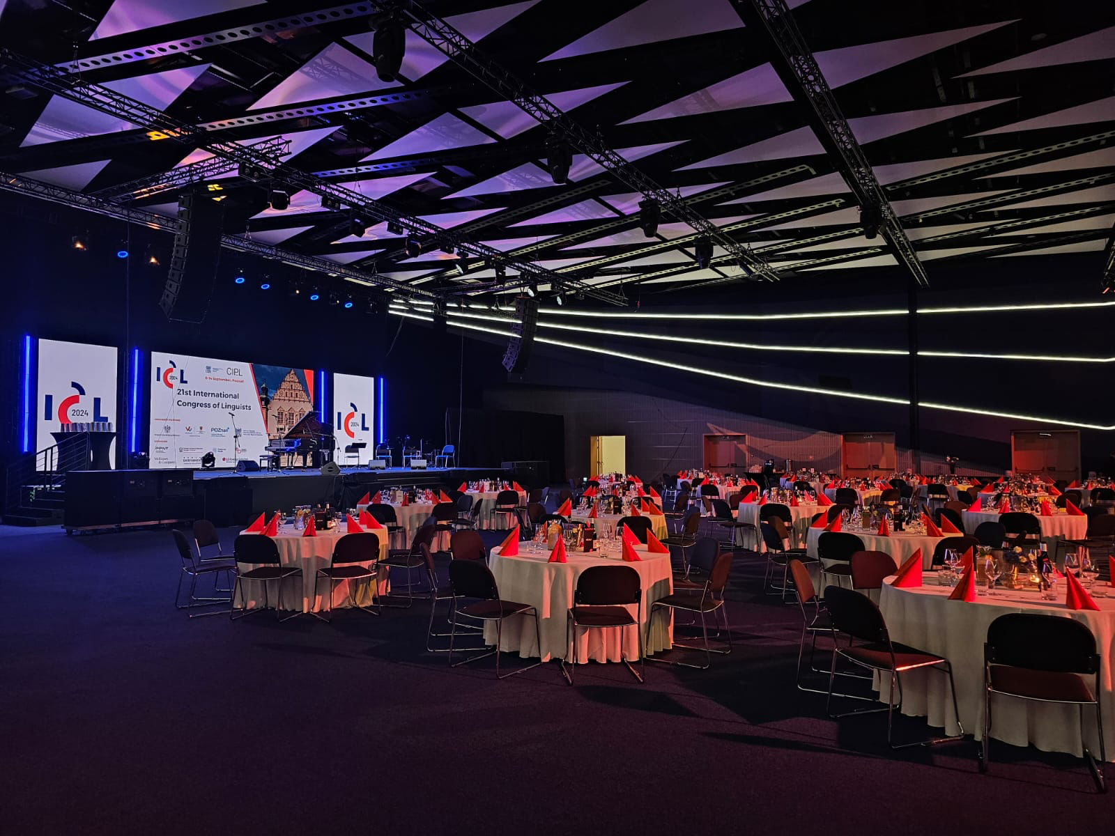
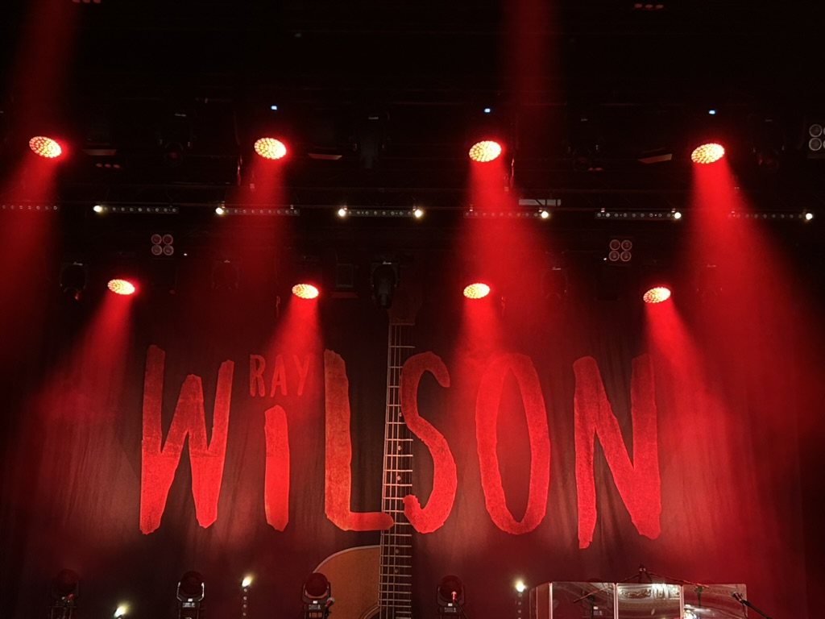
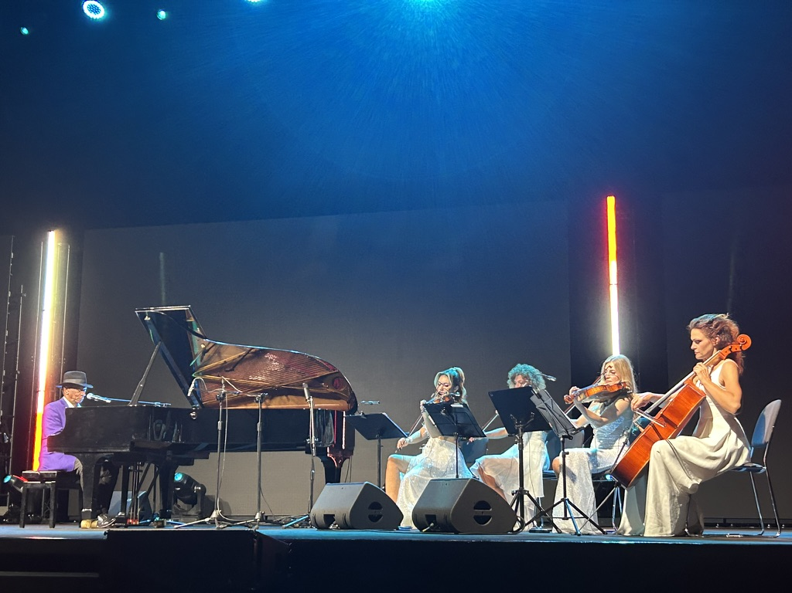

Slide 17
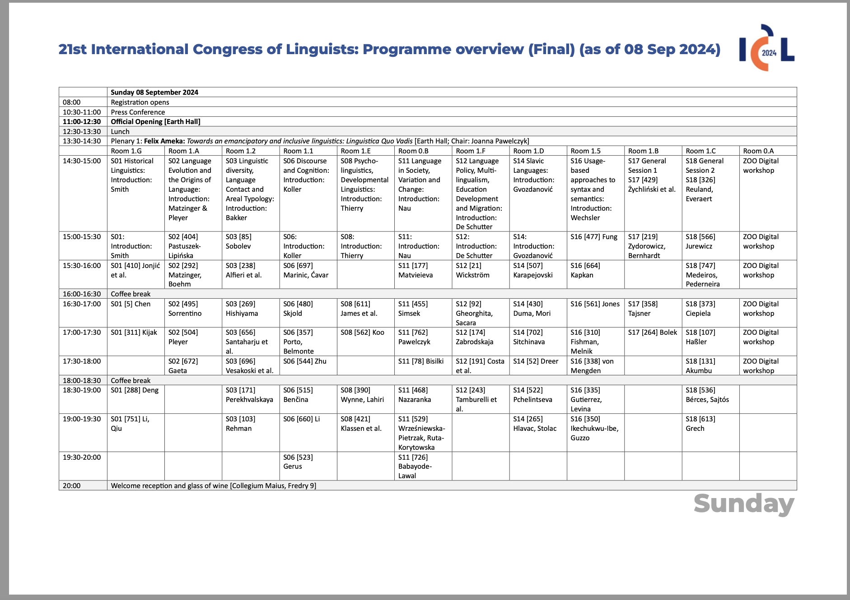
18

Slide 18
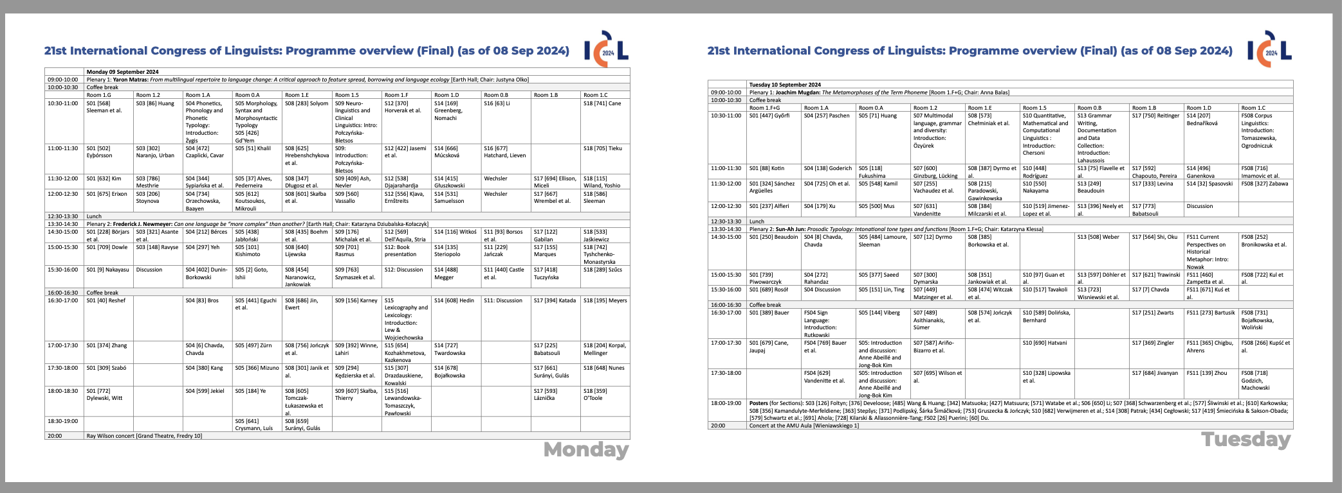
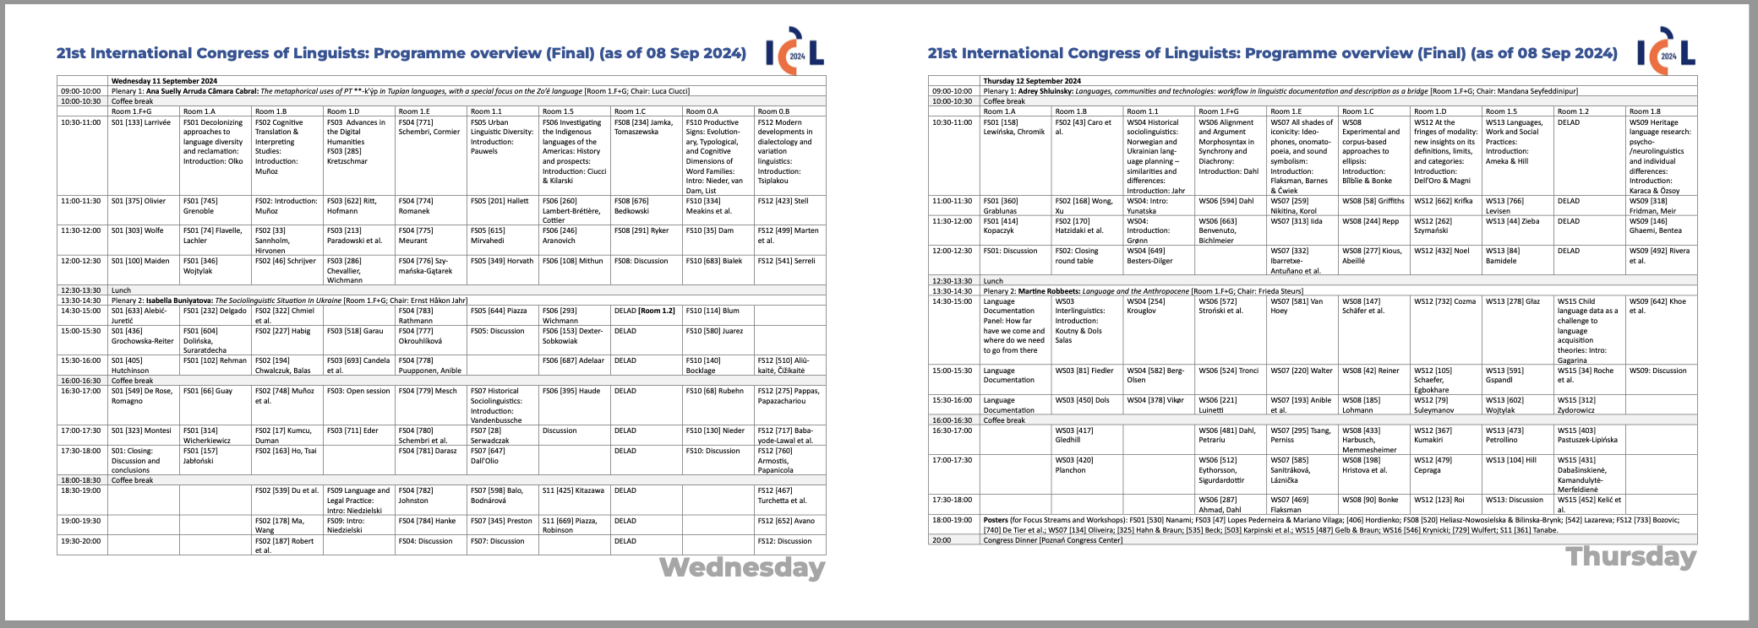

Slide 19
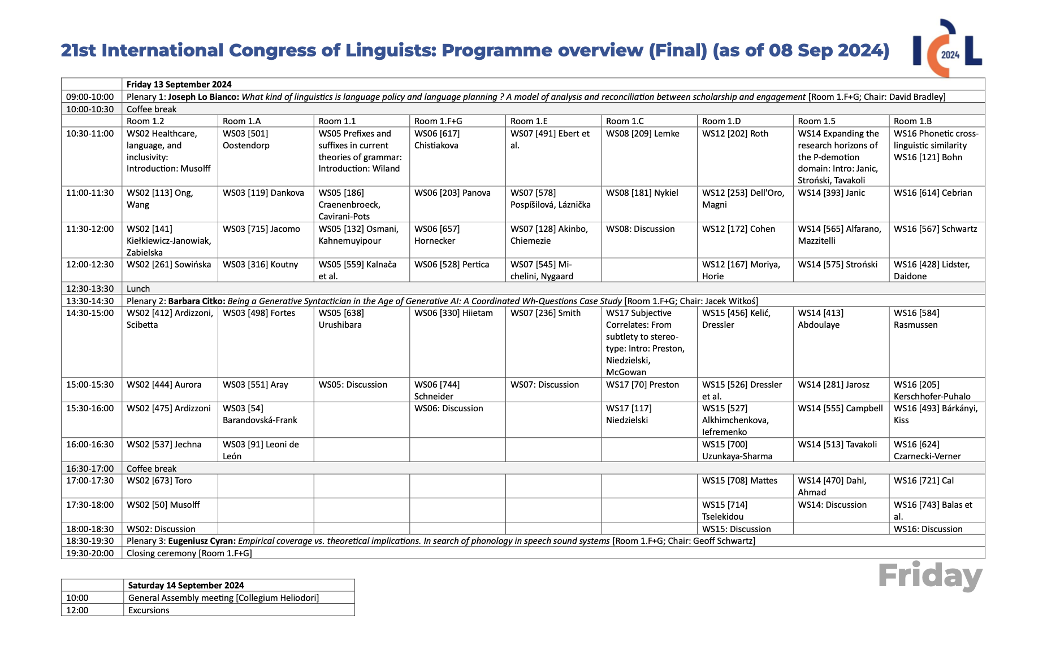
20

Slide 20
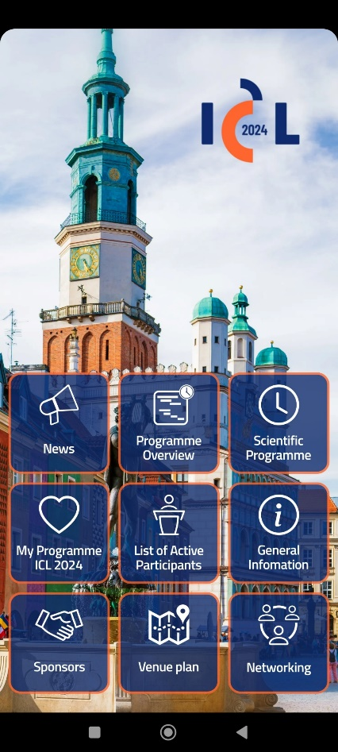
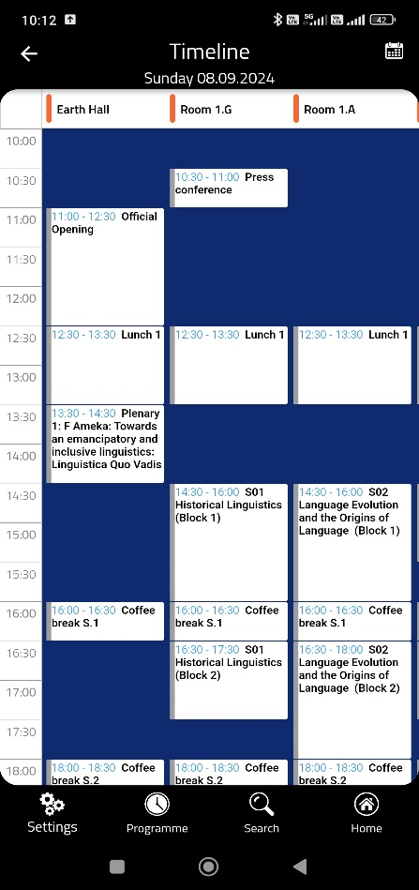
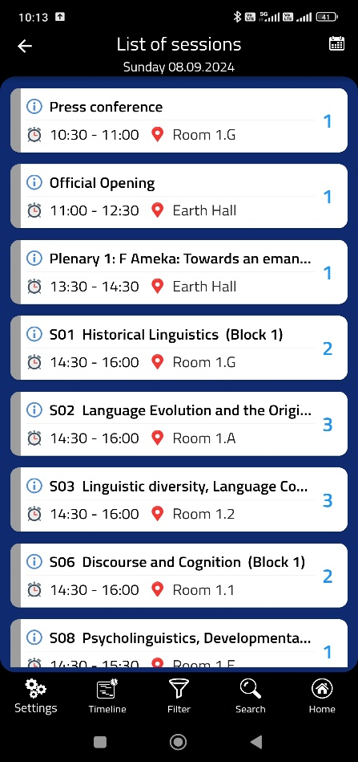
Mobile app
21

Slide 21
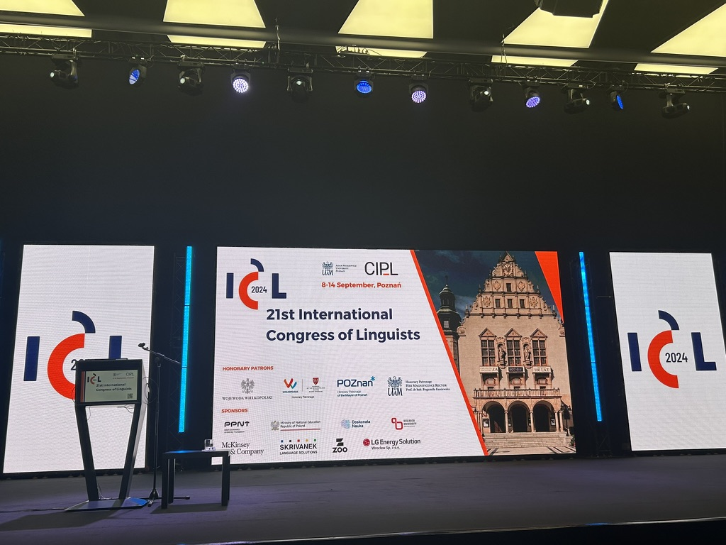
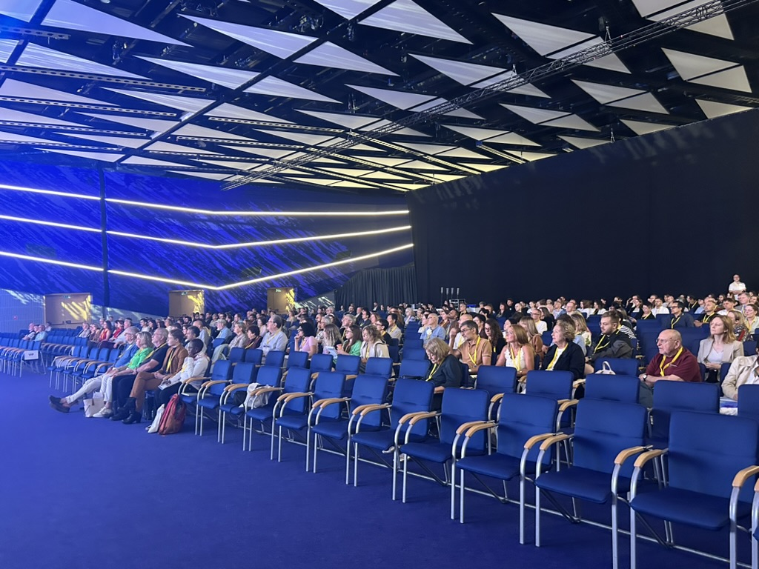
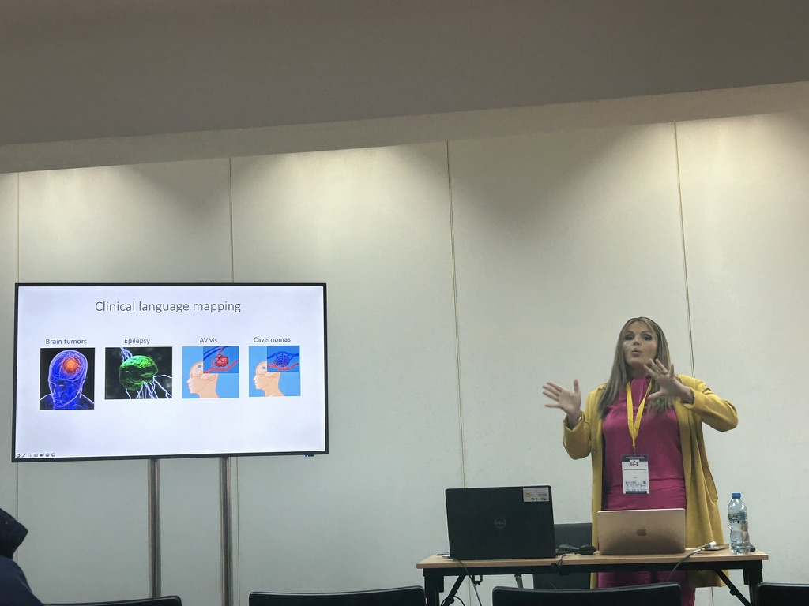
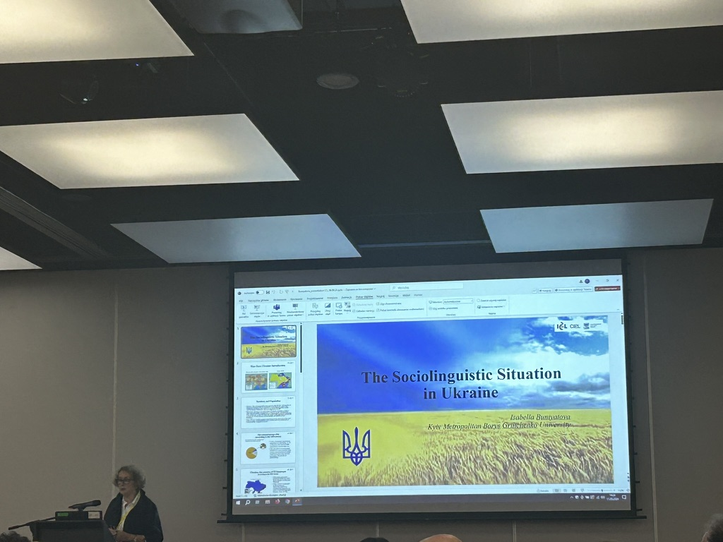
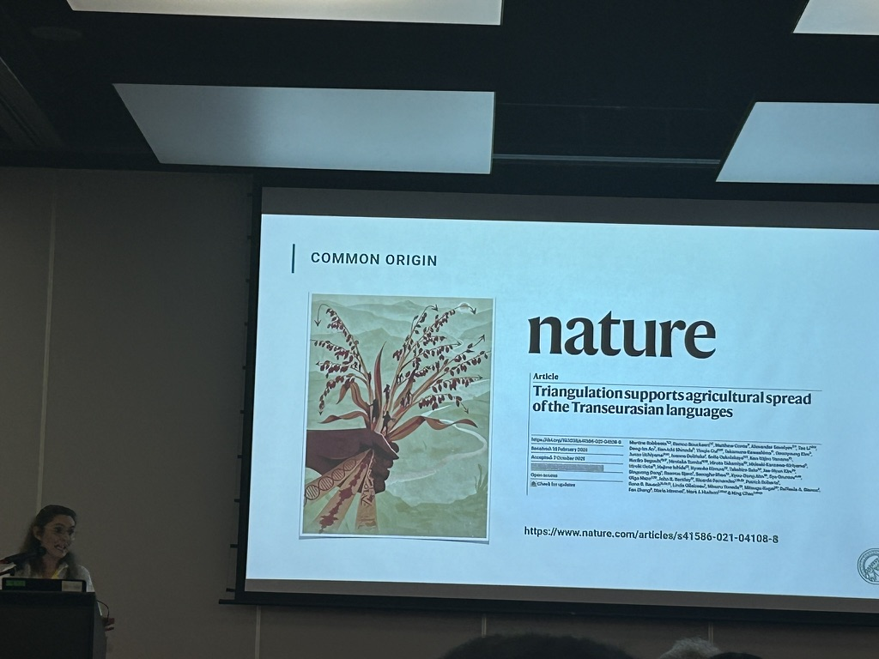

Slide 22
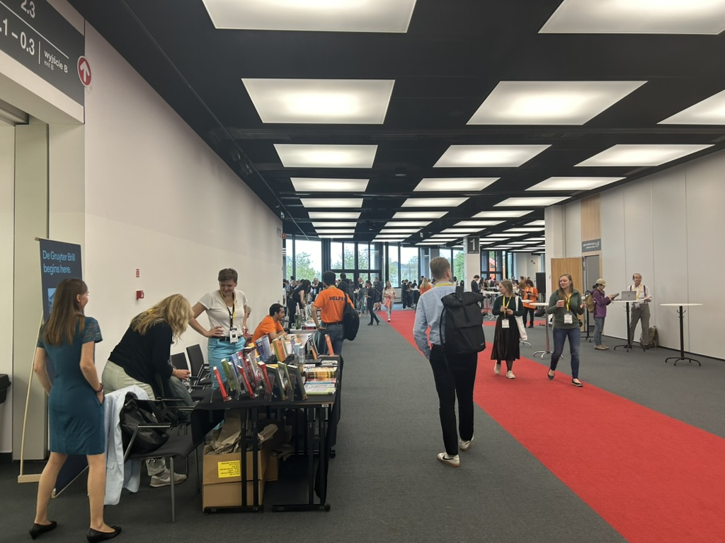
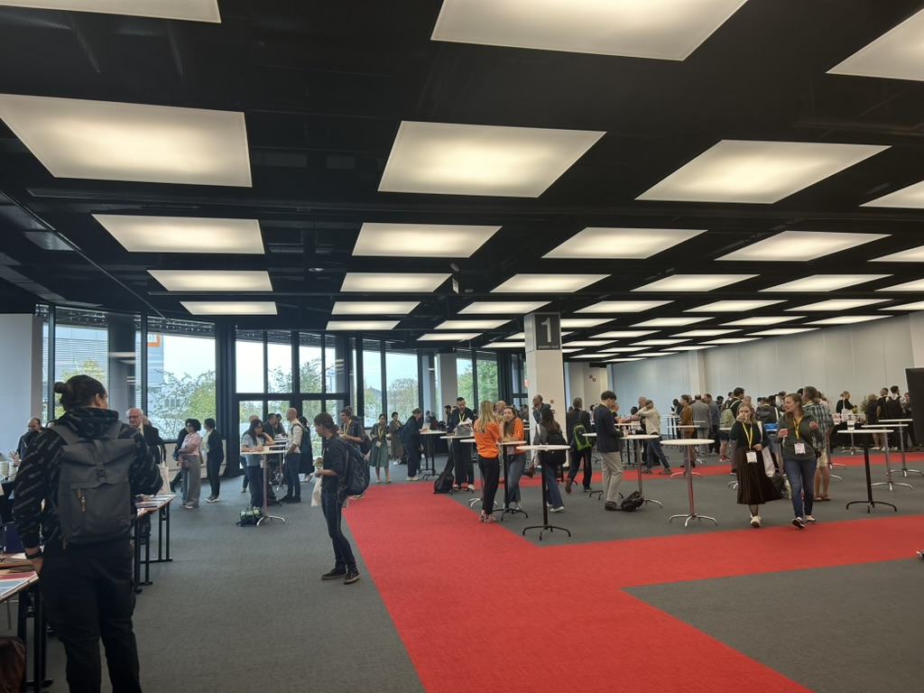
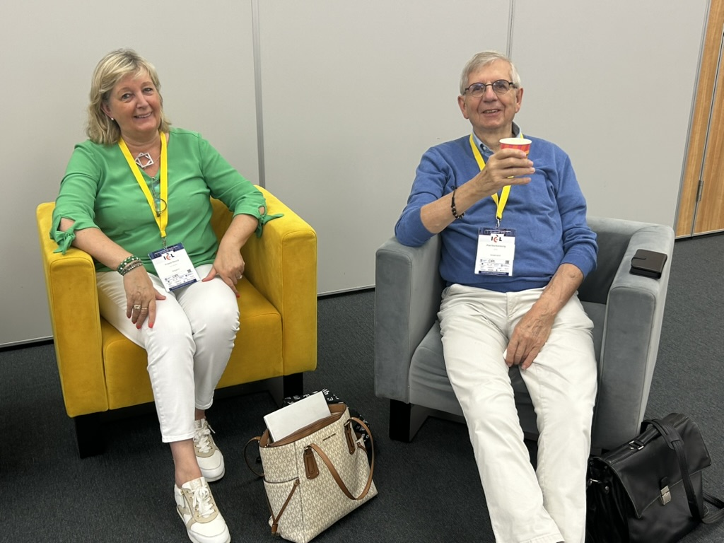

Slide 23
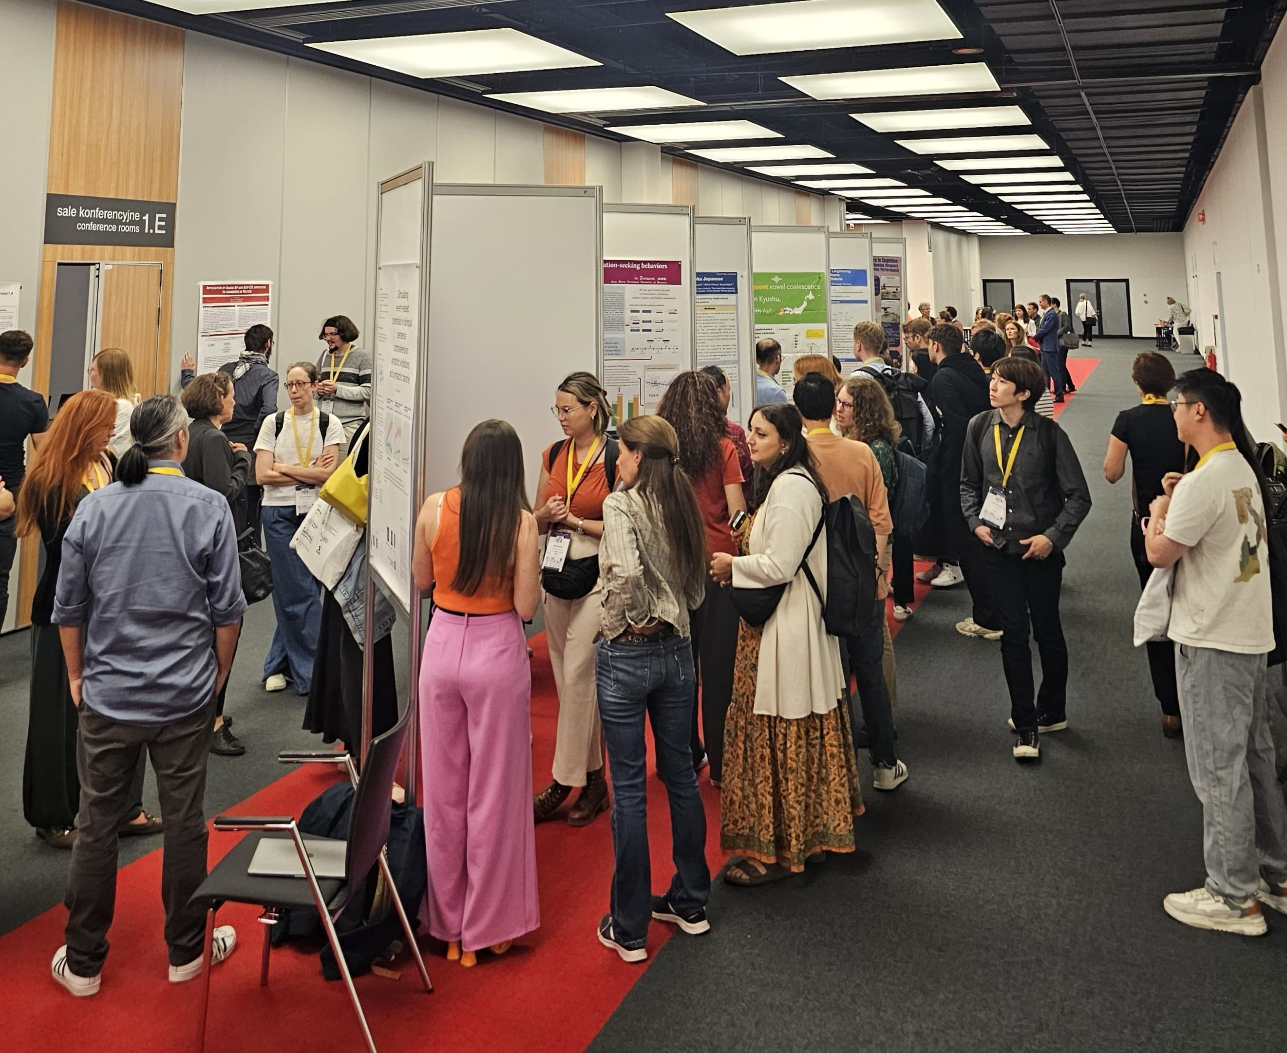
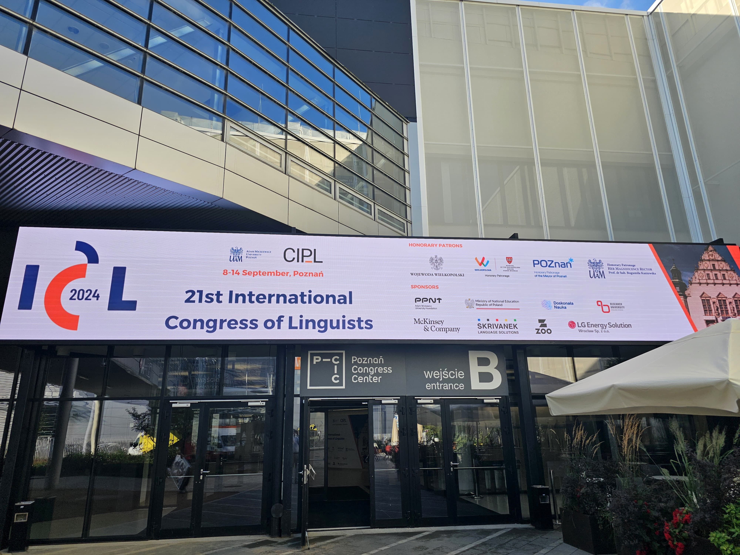
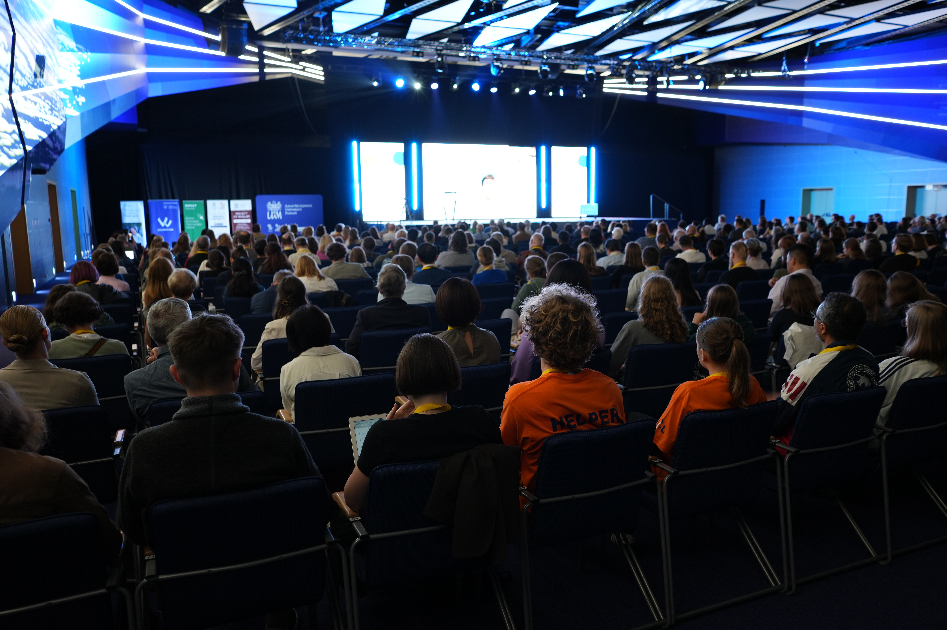

Slide 24




ICL 2024 – external funding
1. Funds from the state budget, allocated by the Minister of Education and Science under the ‘Excellent Science II’ Programme
253 140 PLN
2. Funding as part of the FUND_AKCJA competition organised by the Poznań Science and Technology Park of the Adam Mickiewicz University Foundation
10 000 PLN
3. Funding from the competition launched in the ‘Excellence Initiative - Research University’ project
300 000 PLN
25

Slide 25



ICL 2024 – sponsors
20 000 PLN
1000 USD
5000 PLN
26

Slide 26



ICL 2024 – promotional materials from sponsors
maps of Poznań
lanyards
bags
27

Slide 27
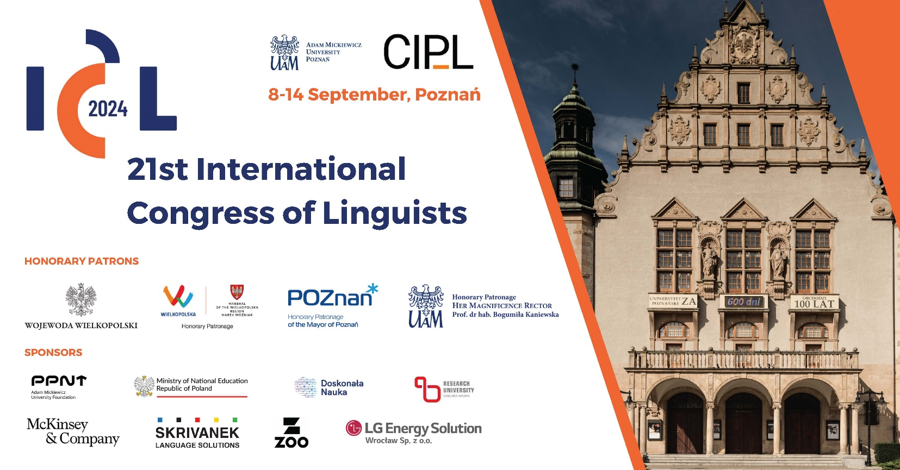
ICL 2024 – logo, posters, banners
28

Slide 28
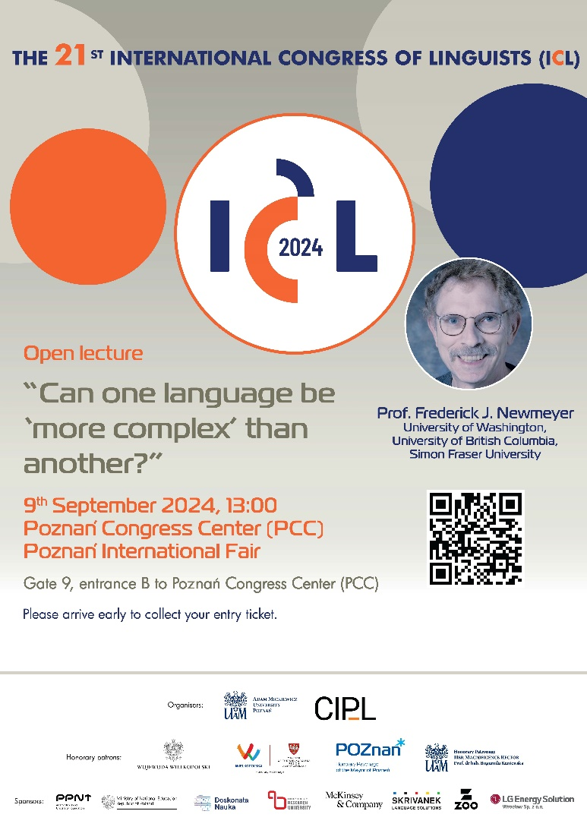
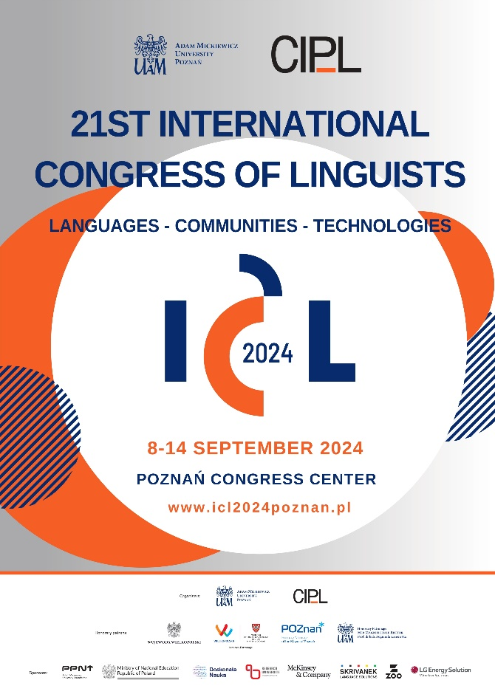
ICL 2024 – posters, banners
29

Slide 29
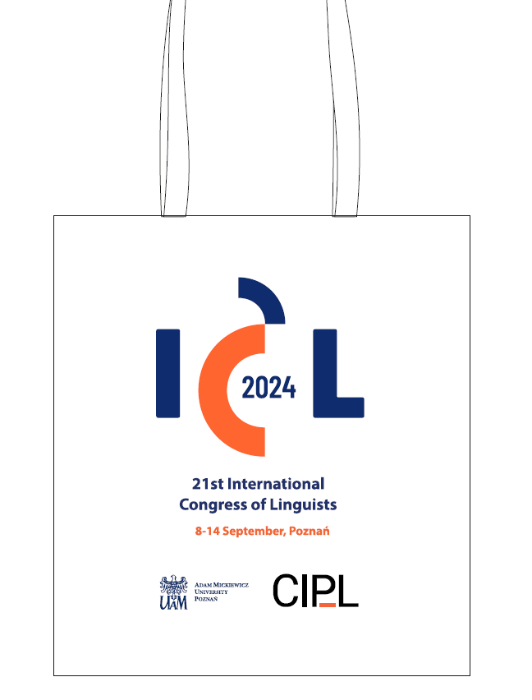
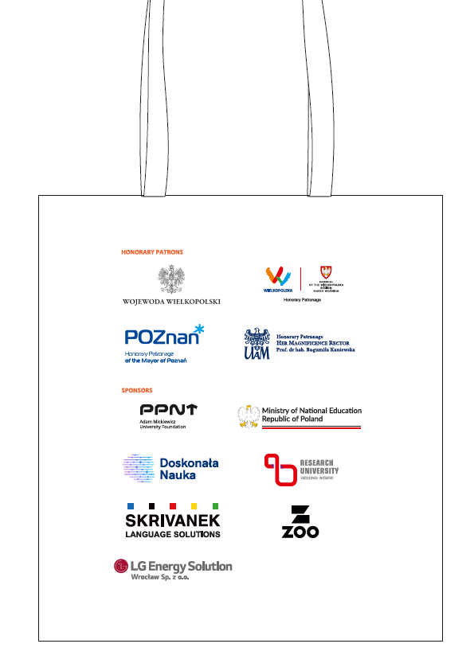
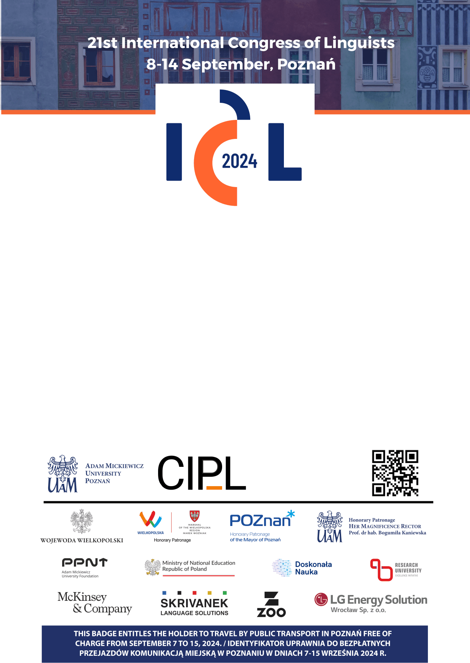
ICL 2024 – bags, tags
30

Slide 30
ICL 2024 – financial basics
FEES
EARLY BIRD (until 31 May)
Regular = € 375
Student = € 275*
STANDARD (until 07 Sep)
Regular = € 475
Student = € 375*
ON SITE
Regular = € 495
Student = € 395*
INVITED = € 0
AMU Researchers = € 100
Exhibitor fee = € 1000
Accompanying person = € 100
Travel grants
CIPL offers 5 travel grants of € 500 each (approx. US$ 550) for advanced students in
linguistics without a PhD presenting at the ICL2024
Total cost of organisation
1 236 891,77 PLN
31

Slide 31
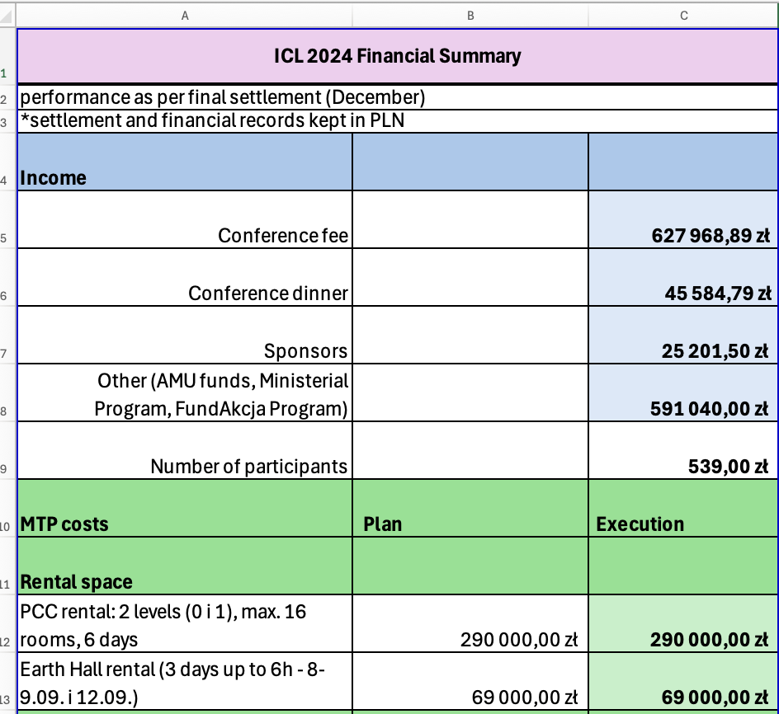
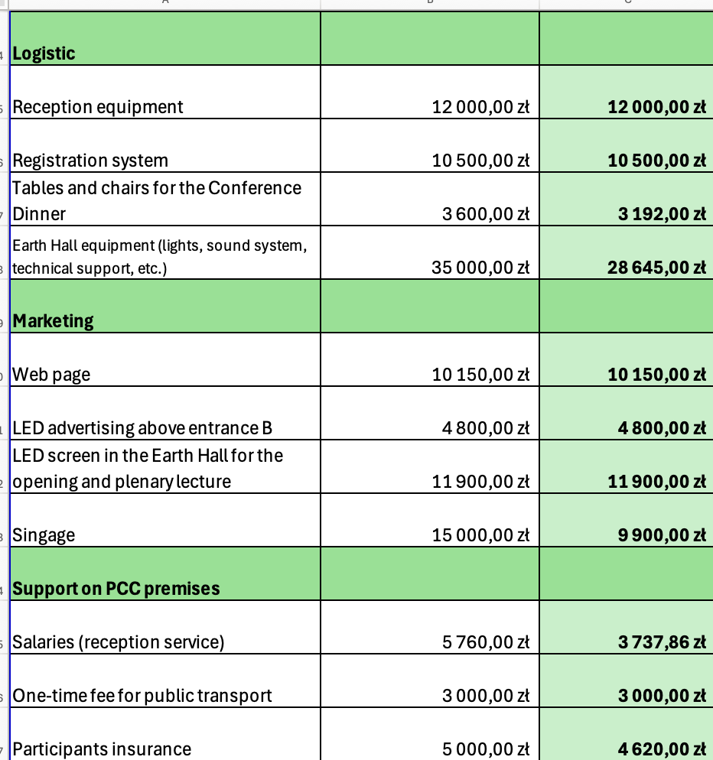

Slide 32
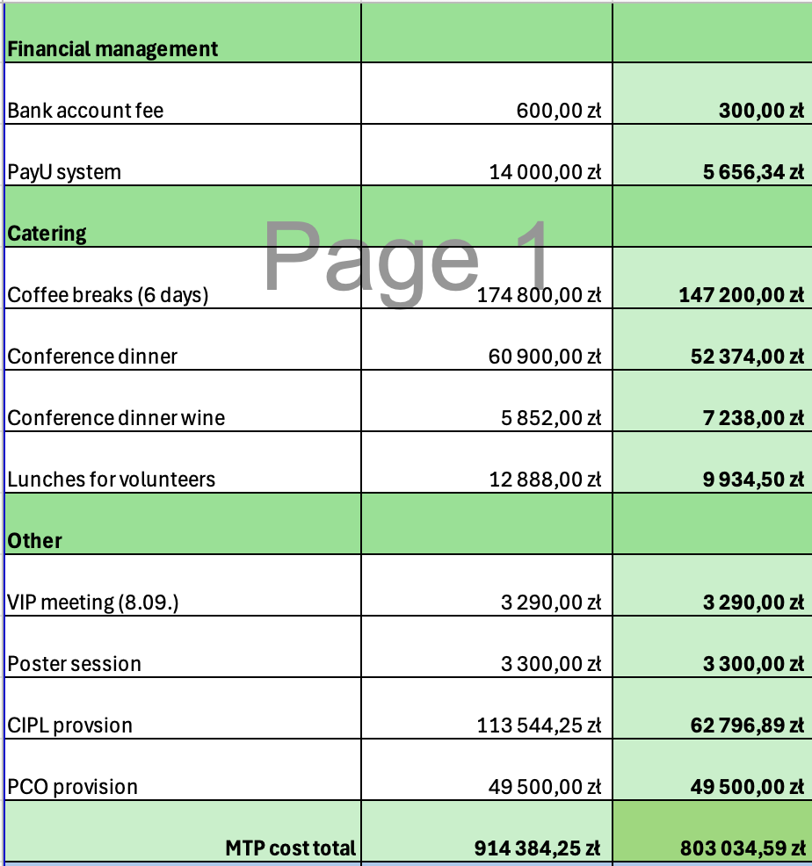
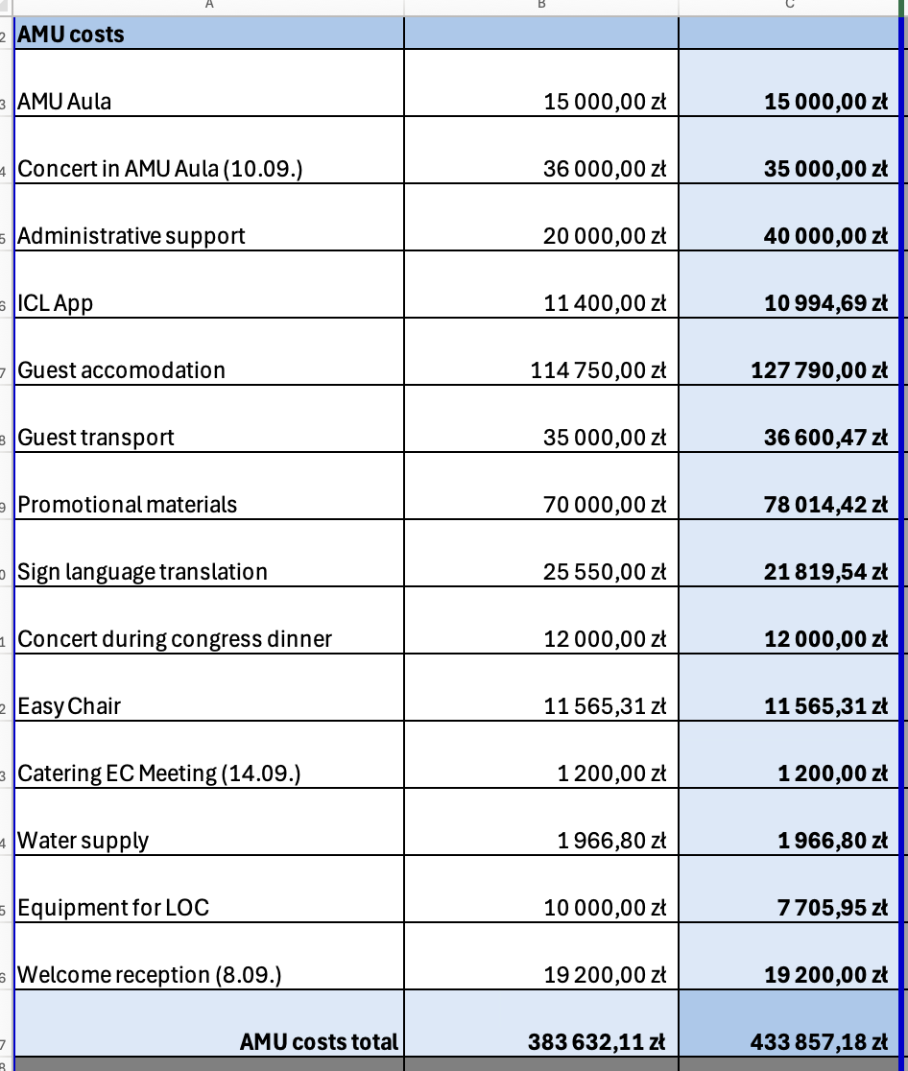

Slide 33
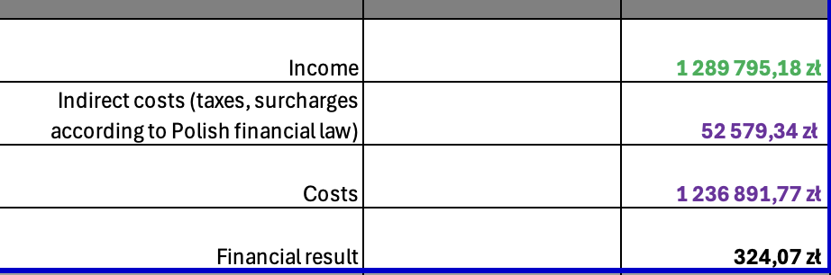
35

Slide 34
Special thanks to Camiel, Frieda and Piet !
Greetings from Poznań to all!

Slide 35
ICL 2024 – wykłady plenarne
Prof. Frederick J. Newmeyer, University of Washington, University of British Columbia, and Simon Fraser University (Canada)
Prof. Joachim Mugdan, University of Münster (Germany)
Prof. Felix Ameka, Leiden University/CIPL Member (The Netherlands)
Prof. Joseph Lo Bianco, University of Melbourne (Australia)
Prof. Barbara Citko, University of Washington (USA)
Prof. Sun-Ah Jun, University of California Los Angeles (USA)
Prof. Ana Suelly Arruda Câmara Cabral, University of Brasilia (Brazil)
Prof. Yaron Matras, Aston University (UK)
Prof. Martine Robbeets, Max Planck Institute for Geoanthropology (Germany)
Dr Andrey Shluinsky, University Hamburg (Germany)
Prof. Isabella Buniyatova, Kyiv Borys Grinchenko University (Ukraine)
Prof. Eugeniusz Cyran, The John Paul II University of Lublin (Poland)

Slide 36
ICL 2024 – sesje tematyczne
1. Historical Linguistics (convenor: John Charles Smith)
2. Language Evolution and the Origins of Language (convenor: George van Driem)
3. Linguistic diversity, Language Contact and Areal Typology (convenor: Peter Bakker)
4. Phonetics, Phonology and Phonetic Typology (convenor: Marzena Żygis)
5. Morphology, Syntax and Morphosyntactic Typology (convenors: Anne Abeillé & Jong-Bok Kim)
6. Discourse and Cognition (convenor: Veronika Koller)
7. Multimodal language, grammar and diversity (convenor: Asli Özyürek)
8. Psycholinguistics, Developmental Linguistics (convenor: Guillaume Thierry)
9. Neurolinguistics and Clinical Linguistics (convenor: Monika Połczyńska-Bletsos)
10. Quantitative, Mathematical and Computational Linguistics (convenors: Chu-Ren Huang and Emmanuel Chersoni)
11. Language in Society, Variation and Change (convenor: Nicole Nau)
12. Language Policy, Multilingualism, Education Development and Migration (convenor: Helder De Schutter)

Slide 37
ICL 2024 – sesje tematyczne
13. Grammar Writing, Documentation and Data Collection (convenor: Aimée Lahaussois) 14. Slavic Languages (convenor: Jadranka Gvozdanović)
15. Lexicography and Lexicology (convenors: Robert Lew and Sylwia Wojciechowska)
16. Usage-based approaches to syntax and semantics (convenor: Stephen Wechsler)
17. General session (convenors: Jae Woong Choe and Hye-Sook Kim)
18. General section (convenors: Piotr Gasiorowski and Jacek Witkoś)

Slide 38
ICL 2024 – focus streams
1. Decolonizing approaches to language diversity and reclamation (convenor: Justyna Olko)
2. Cognitive Translation & Interpreting Studies (convenor: Ricardo Munoz Martin)
3. Advances in the Digital Humanities (convenors: Raymond Siemens, Jan Rybicki, and Maciej Eder)
4. Sign Language (convenor: Paweł Rutkowski)
5. Urban Linguistic Diversity (convenor: Anne Pauwels)
6. Investigating the Indigenous languages of the Americas: History and prospects (convenors: Luca Ciucci and Marcin Kilarski)
7. Historical Sociolinguistics (convenor: Wim Vandenbussche)
8. Corpus Linguistics (convenor: Maciej Ogrodniczuk)
9. Language and Legal Practice (convenor: Nancy Niedzielski)
10. Productive Signs: Evolutionary, Typological, and Cognitive Dimensions of Word Families (convenors: Jessica Nieder and Kellen Parker Van Dam)
11. Current Perspectives on Historical Metaphor (convenor: Krzysztof Nowak)
12. Modern developments in dialectology and variation linguistics (convenor: Stavroula Tsiplakou)

Slide 39
ICL 2024 – special panels
1. DELAD/CLARIN workshop: Collecting and Sharing Corpora for Language and Speech Disorders
2. Language documentation: How far have we come and where do we need to go from there (organized by Mandana Seyfeddinipur)
3. ZOO Digital workshop: Is AVT doomed because of AI? Workshop on the not-yet-extinct type of translation (convenors: Mariusz Arno Jaworowski, Maria Kuczek)

Slide 40
ICL 2024 – warsztaty
1. Modelling holistic clinical assessment of linguistically diverse speech, and an example (convenor: Elena Babatsouli)
2. Healthcare, language, and inclusivity (convenors: Kayo Kondo, Andreas Musolff, Sara Vilar-Lluch, Tachen Zhou)
3. Interlinguistics (convenors: Ilona Koutny and Nicolau Dols Salas)
4. Historical sociolinguistics: Norwegian and Ukrainian language planning – similarities and differences (convenor: Ernst Håkon Jahr)
5. Prefixes and suffixes in current theories of grammar (convenor: Bartosz Wiland)
6. Alignment and Argument Morphosyntax in Synchrony and Diachrony (convenor: Eystein Dahl)
7. All shades of iconicity: Ideophones, onomatopoeia, and sound symbolism (convenors: Maria Flaksman, Kathryn Barnes, and Aleksandra Ćwiek)
8. Experimental and corpus-based approaches to ellipsis (convenors: Gabriela Bîlbîie and Max Bonke)
9. Heritage language research through the lens of psycho-/neurolinguistics and individual differences (convenors: Figen Karaca & Onur Özsoy)

Slide 41
ICL 2024 – warsztaty
10. Kaaps linguistics in contemporary South Africa (convenor: Quentin Williams)
11. Diachronic dynamics and typology of similarity and identity avoidance (convenors: Erika Just, Laura Dees, Catalina Torres Orjuela, and Thomas Huber)
12. At the fringes of modality: new insights on its definitions, limits, and categories (Francesca Dell’Oro and Elisabetta Magni)
13. Languages, Work and Social Practices (convenors: Felix K. Ameka and Deborah Hill)
14. Expanding the research horizons of the P-demotion domain: the crosslinguistic variation, diversity, and boundaries (convenors: Katarzyna Janic, Krzysztof Stroński, and Mohammad Tavakoli)
15. Child language data as a challenge to language acquisition theories (convenors: Natalia Gagarina, Elitzur Dattner, Wolfgang Dressler, and Dorit Ravid)
16. Phonetic cross-linguistic similarity (convenors: Anna Balas and Romana Kopečková)
17. Subjective Correlates: From subtlety to stereotype (convenors: Dennis Preston, Nancy Niedzielski, and Kevin McGowan)

